Slide 1


Chiropractic Care:
A Non-Pharmacological Alternative to Opioids
Presented by the Georgia Chiropractic Association (GCA)
12-11-2024

Slide 2

Chiropractic as Primary Portal-of-Entry Providers
Chiropractors are licensed to diagnose, and manage neuromusculoskeletal conditions.
  Imaging Diagnostic and Laboratory Capabilities:
    Chiropractors are trained to interpret X-rays, MRIs, and other imaging modalities.
    Ability to identify red flags, co-morbid conditions, and refer patients for further medical care when necessary.
  Ideal for Non-Pharmacological Care Teams:
    Expertise in musculoskeletal disorders and pain management.
    Early intervention to reduce reliance on opioids.

Slide 3

Chiropractic Education
Training to become a chiropractor takes eight years of college (four undergraduate years followed by three to five at chiropractic college) and then a clinical internship.
In the United States, the Council on Chiropractic Education (CCE) accredits chiropractic programs and institutions.
    To earn accreditation, chiropractic colleges must meet a variety of stringent requirements. Each program’s curriculum must include at least 4,200 credit hours.
    Chiropractic students follow a curriculum that includes: anatomy, human physiology, biochemistry, nutrition, pharmatoxicology, pathology, emergency care, microbiology, diagnostic imaging and more.
Source: Council on Chiropractic Education

Slide 4
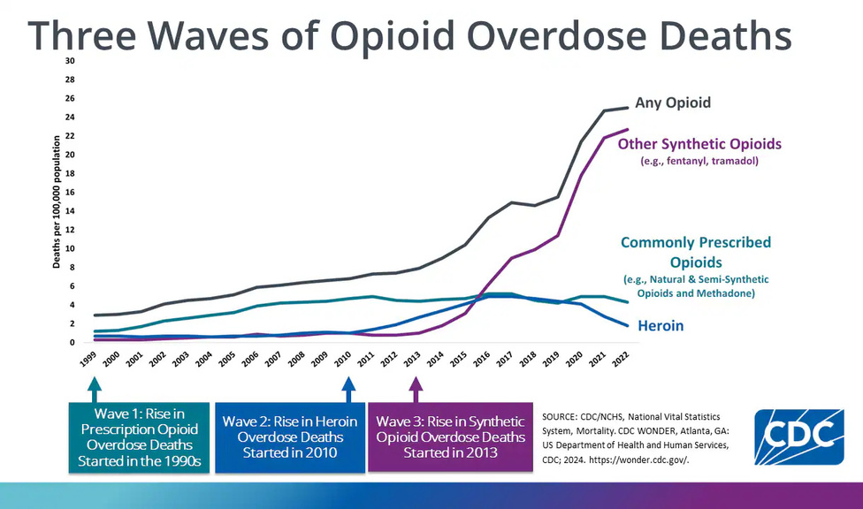
The Problem
50 MILLION
Over 50 million people in the U.S. suffer from chronic pain. Among people who have chronic pain, almost two-thirds still suffer from it a year later.
224 PEOPLE
On average, 224 people die each day from an opioid overdose in the United States.
8.6 MILLION
The opioid crisis has highlighted an urgent need for safe, effective, and evidence-based alternatives to pharmacological interventions for pain management. Non-drug therapies, such as chiropractic care, provide patients with options that not only address pain but also reduce the risks of dependency, side effects, and long-term health complications associated with opioid use.
In 2023, nearly 8.6 million Americans 12 years and older reported misusing prescription opioids.
Centers for Disease Control and Prevention. (2023)

Slide 5
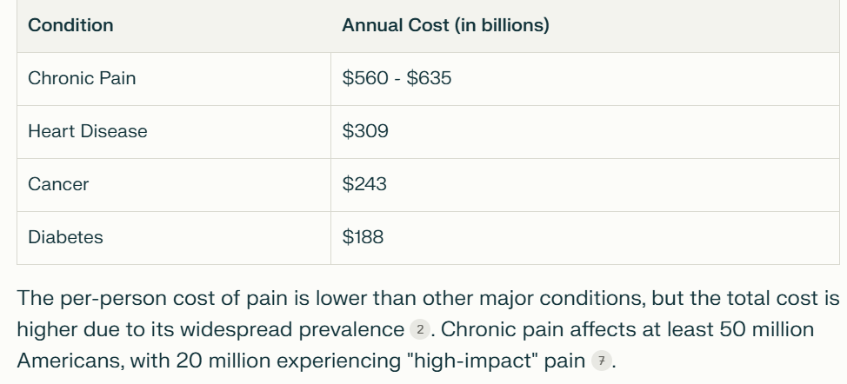
THE COST OF CHRONIC PAIN
Chronic pain affects millions of adults in the United States, with an annual cost in personal and health system expenditures conservatively estimated at $560 billion to $635 billion.
These disorders often get prescribed pain medication. Chiropractic is a safer approach for acute, subacute and chronic pain.
Noninvasive Nonpharmacological Treatment for Chronic Pain: A Systematic Review Update]

Slide 6





CDC Clinical Practice Guideline for Prescribing Opioids for Pain — United States, 2022
Four key areas are covered in this clinical practice guideline for prescribing of opioid pain medication for patients aged ≥18 years for pain, excluding pain management related to sickle cell disease, cancer-related pain treatment, palliative care, and end-of-life care.
DETERMINING WHETHER OR NOT TO INITIATE OPIOIDS FOR PAIN
Before starting opioid therapy for subacute or chronic pain, clinicians should discuss with patients the realistic benefits and known risks of opioid therapy, should work with patients to establish treatment goals for pain and function, and should consider how opioid therapy will be discontinued if benefits do not outweigh risks
SELECTING OPIOIDS AND DETERMINING OPIOID DOSAGES
DECIDING DURATION OF INITIAL OPIOID PRESCRIPTION AND CONDUCTING FOLLOW-UP
ASSESSING RISK AND ADDRESSING POTENTIAL HARMS OF OPIOID USE.

Slide 7
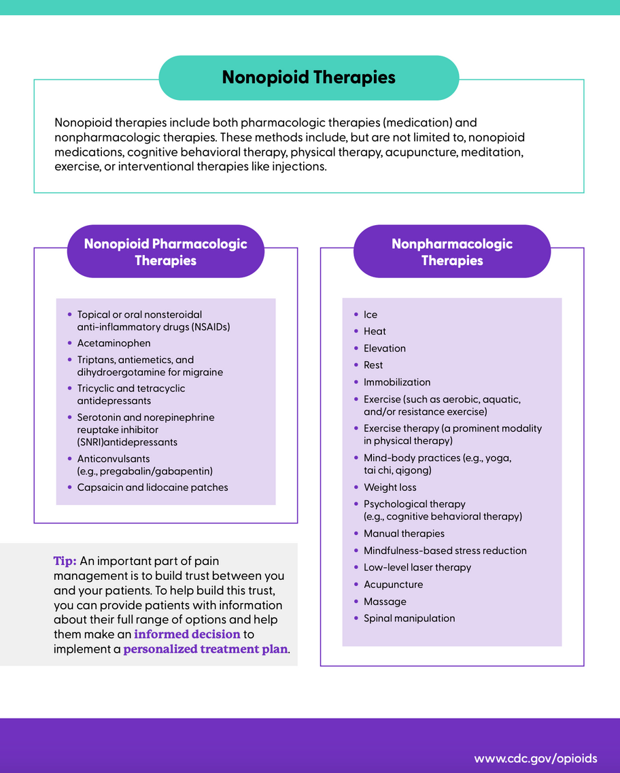
CDC Clinical Practice Guideline for Prescribing Opioids for Pain — United States, 2022
According to the CDC guidelines, preferred alternatives to opioids for pain management include non-pharmacological therapies like exercise, physical therapy, acupuncture, massage, and cognitive behavioral therapy (CBT), along with over-the-counter medications; opioids should only be considered when other options are not sufficient and the potential benefits outweigh the risks.
The CDC recommends utilizing non-opioid therapies as the first line of treatment for pain management whenever possible.
WWW.CDC.GOV/OPIOIDS

Slide 8
Noninvasive Nonpharmacological Treatment for Chronic Pain: A Systematic Review
Agency for Healthcare Research and Quality (US); 2020 Apr.
Evidence exists that multiple noninvasive nonpharmacologic interventions improve chronic pain and function, with small to moderate effects in specific pain conditions, and are not associated with serious harms.
Compared with medication treatment, for which benefits are anticipated while patients are taking the medication but are not usually expected to persist after patients stop taking the medication, multiple noninvasive nonpharmacologic interventions are associated with improvements in pain, function, or both that are sustained after completion of treatment (9)
Noninvasive Nonpharmacological Treatment for Chronic Pain: A Systematic Review Update]

Slide 9

Noninvasive Nonpharmacological Treatment for Chronic Pain: A Systematic Review
The American College of Physicians (ACP) recommends nonpharmacologic treatment with superficial heat, massage, acupuncture, or spinal manipulation as a cornerstone of treatment for acute low back pain (119).

Slide 10
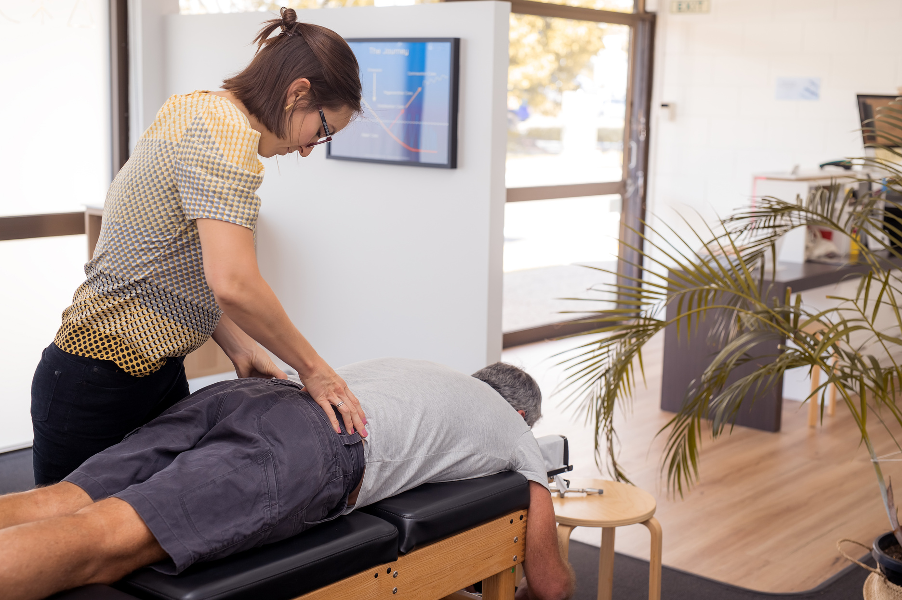
Chiropractic Care as a Non-Pharmacological Solution
Chiropractors’ Role in Pain Management Teams:
  Collaboration with medical doctors, physical therapists, and other healthcare providers.
  GA law permits MD/DC practices
Integrated Imaging Use in Clinical Decision-Making:
The Guidelines of the American College of Physicians (ACP) published in the Annals of Internal Medicine, call for non-drug therapy as a corner stone in the treatments of acute, subacute and chronic low back pain.
  Efficiently guide care plans and ensure evidence-based treatments.
Source: ACP

Slide 11

The Evidence Case for a Non-Pharmacological Approach
Objective
To examine patient sociodemographic and clinical characteristics associated with opioid use among Veterans who receive chiropractic care, and to explore the relationship between timing of a chiropractic visit and receipt of an opioid prescription.
Opioid Use Among Veterans of Recent Wars Receiving Veterans Affairs Chiropractic Care
Methods
Cross-sectional analysis of administrative data on veterans who had at least one visit to a Veterans Affairs (VA) chiropractic clinic between 2004 and 2014. Opioid receipt was defined as at least one prescription within a window of 90 days before to 90 days after the index chiropractic clinic visit.
Pain Med. 2018 Sep 1
Results
Nearly one-third of veterans receiving VA chiropractic services also received an opioid prescription, yet the frequency of opioid prescriptions was lower after the index chiropractic visit than before.

Slide 12
Objective
The Evidence Case for a Non-Pharmacological Approach
The objective of this investigation was to evaluate the association between utilization of chiropractic services and the use of prescription opioid medications.
Methods
The authors measured likelihood of opioid prescription fill among recipients of services delivered by doctors of chiropractic compared with nonrecipients. They also compared the cohorts with regard to rates of prescription fills for opioids and associated charges.
Association Between Utilization of Chiropractic Services for Treatment of Low-Back Pain and Use of Prescription Opioids
Results
J Altern Complement Med. 2018 Jun
The adjusted likelihood of filling a prescription for an opioid analgesic was 55% lower among recipients compared with nonrecipients (odds ratio 0.45; 95% confidence interval 0.40-0.47; p < 0.0001). Average charges per person for opioid prescriptions were also significantly lower among recipients. The likelihood of filling a prescription for an opioid analgesic was significantly lower for recipients of services delivered by doctors of chiropractic compared with nonrecipients.

Slide 13
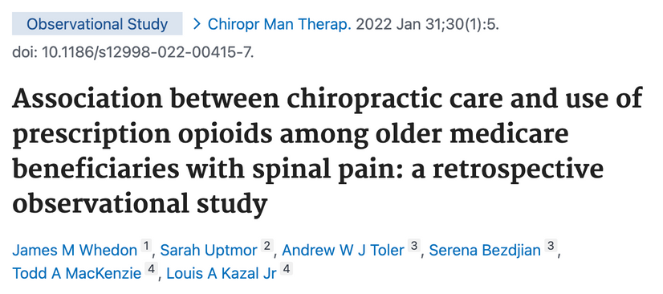
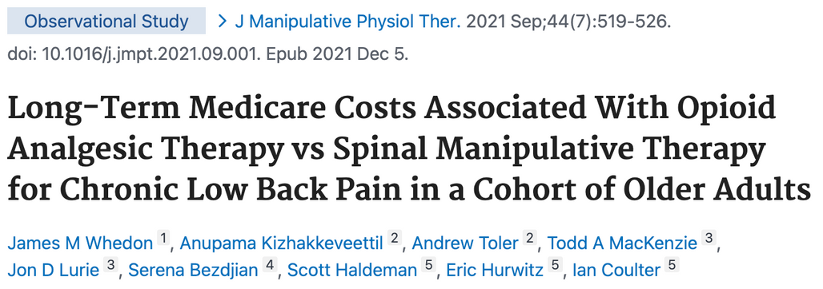
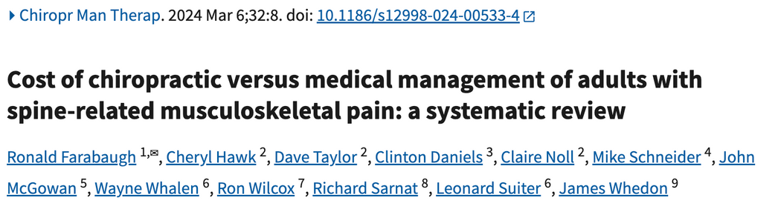
Research on Older Adults and Medicare Populations
Results: The adjusted risk of filling an opioid prescription within 365 days of initial visit was 56% lower among recipients of chiropractic care as compared to non-recipients
Results: Adults aged 65 to 84 who initiated long-term treatment for cLBP via OAT incurred lower long-term costs for low back pain but higher long-term total healthcare costs under Medicare compared with patients who initiated long-term treatment with SMT.
Results: Patients with spine-related musculoskeletal pain who consulted a chiropractor as their initial provider incurred substantially decreased downstream healthcare services and associated costs, resulting in lower overall healthcare costs compared with medical management.

Slide 14
Impact on Quality of Life
84%
According to a recent study, among older Medicare beneficiaries with chronic low back pain, long-term recipients of SMT had higher self-reported rates of HRQoL and greater satisfaction with their modality of care than long-term recipients of prescription drug therapy.
Recipients of SMT were more likely to be very satisfied with their care
Chiropractic care can significantly improve a patient’s quality of life by addressing pain, enhancing mobility, and supporting overall well-being. By combining pain relief, functional improvements, and a patient-centered approach, chiropractic care helps individuals regain their ability to perform daily activities and enjoy an active, fulfilling life.
Source: Journal of Manipulative & Physiological Therapeutics
at 12 weeks the largest percentage improvement was
Results from a recent study demonstrated that chiropractic care can positively impact HRQOL beyond pain and pain-related disability. This along with prior research suggests positive effects of chiropractic care on patient-reported outcomes up to 3 months. The use of PROMIS® measures encompassing physical, mental, and social health provided a richer, more holistic picture of response to chiropractic care.
58%
(pain interference)
Source: Pain Med. 2022 Jan 21

Slide 15
Supporting Research
Opioid analgesia for acute low back pain and neck pain (the OPAL trial): a randomised placebo-controlled trial
Source: The Lancet, July 22, 2023
Results
Between Feb 29, 2016, and March 10, 2022, 347 participants were recruited (174 to the opioid group and 173 to the placebo group). 151 participants in the opioid group and 159 in the placebo group were included in the primary analysis. Mean pain score at 6 weeks was 2·78 (SE 0·20) in the opioid group versus 2·25 (0·19) in the placebo group (adjusted mean difference 0·53, 95% CI –0·00 to 1·07, p=0·051). 61 (35%) of 174 participants in the opioid group reported at least one adverse event versus 51 (30%) of 172 in the placebo group (p=0·30), but more people in the opioid group reported opioid-related adverse events (eg, 13 [7·5%] of 174 participants in the opioid group reported constipation vs six [3·5%] of 173 in the placebo group).
Opioids should not be recommended for acute non-specific low back pain or neck pain given that we found no significant difference in pain severity compared with placebo. This finding calls for a change in the frequent use of opioids for these conditions.
Background
Opioid analgesics are commonly used for acute low back pain and neck pain, but supporting efficacy data are scarce. We aimed to investigate the efficacy and safety of a judicious short course of an opioid analgesic for acute low back pain and neck pain.
Methods
OPAL was a triple-blinded, placebo-controlled randomised trial that recruited adults presenting to one of 157 primary care or emergency department sites with 12 weeks or less of low back or neck pain (or both) of at least moderate pain severity. Participants were randomly assigned (1:1) using statistician-generated randomly permuted blocks to guideline-recommended care plus an opioid or guideline-recommended care and an identical placebo, for up to 6 weeks.

Slide 16
Chiropractic care is a non-pharmacological alternative to Opioids
  Services that are provided by chiropractors are considered the cornerstone of care in pain management, these services are all non-pharmacological interventions
  Chiropractors are primary care providers who are licensed to diagnose and treat Neuromuscular conditions
  Chiropractors work intimately with other healthcare providers.
  Chiropractic physical examinations, help screen for life threatening disorders, like heart disease, cancer, and diabetes. We refer to the appropriate physician for early medical diagnosis and intervention.

Slide 17
Thank you!
Presented by the Georgia Chiropractic Association (GCA)

